Slide 1

Cancer Issue Project Analysis
Presented By:-Ankit Rajak
Project File:-Cancer Issue Analysis

Slide 2
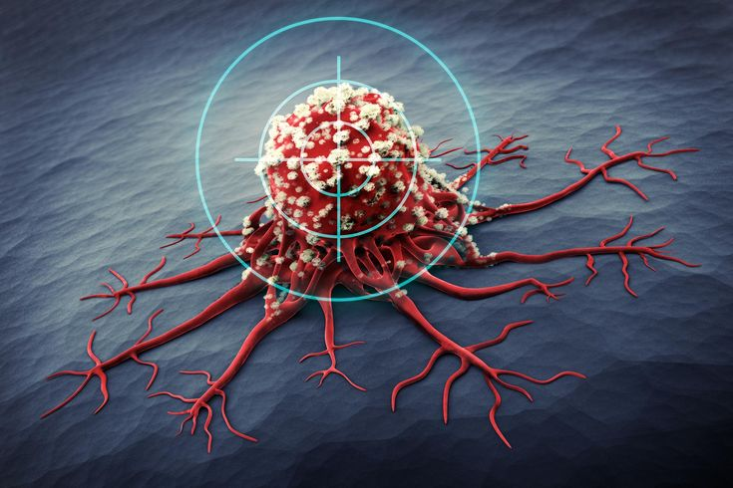
Introduction:-
Cancer is a complex group of diseases characterized by the uncontrolled growth and spread of abnormal cells in the body. It can develop in almost any tissue or organ and has the potential to invade or spread to other parts of the body, often disrupting normal bodily functions. There are more than 100 different types of cancer, including breast, lung, skin, colon, and prostate cancer, each with unique causes, symptoms, and treatment options.
Cancer occurs when genetic mutations or damage to DNA result in abnormal cell behavior, leading to unchecked cell growth. Factors such as lifestyle choices (e.g., smoking, diet), environmental exposures (e.g., radiation, carcinogens), and genetic predispositions contribute to the risk of developing cancer.
Advances in medical research have led to improved methods of detection, diagnosis, and treatment, including surgery, chemotherapy, radiation, and immunotherapy. Despite these advancements, cancer remains a leading cause of death globally, making early detection, prevention, and continuous research crucial in reducing its impact and improving survival rates.

Slide 3
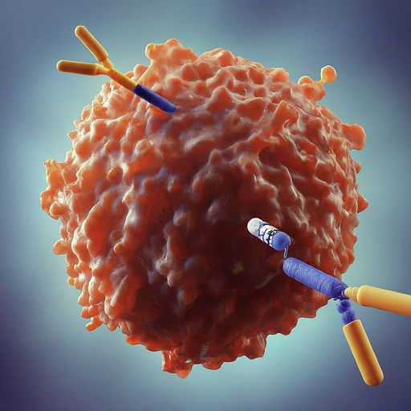
Objective:-
The objective in addressing the issue of cancer is multifaceted, aiming to reduce its incidence, improve outcomes for patients, and enhance quality of life for those affected. First and foremost, a primary goal is to increase awareness and education about cancer prevention, early detection, and the importance of regular screenings. By empowering individuals with knowledge on healthy lifestyles, such as avoiding tobacco, limiting alcohol consumption, and maintaining a balanced diet, the risk of certain types of cancer can be reduced.
Another key objective is advancing cancer research to uncover the underlying causes of cancer, improve diagnostic tools, and develop more effective treatments. Personalized medicine, which tailors treatment to an individual’s genetic makeup, is a rapidly growing field that holds significant promise in offering better outcomes for cancer patients.
Furthermore, improving access to cancer care is vital. Many people in underserved areas face barriers to diagnosis, treatment, and support. Strengthening healthcare systems and ensuring that life-saving treatments are accessible to all individuals, regardless of their socioeconomic status, is a critical objective.
Finally, providing emotional, psychological, and social support for cancer patients and their families is essential. Addressing both the physical and mental challenges of cancer helps to improve overall well-being and ensure a better quality of life for those affected.

Slide 4

Key Questions:-
1.Find Out Smoking Status.
2.Find Out Count Of Race/Ethnicity And Hospital Region.
3.Find Out Smoking Status Distribution By Gender.
4.Find Out Distribution Of Cancer Types.
5.Find Out Distribution Of Cancer Stage.
6.Find Out Distribution Of Tumor Size.
7.Find Out Distribution Of Cancer Types By Gender.
8.Find Out Treatment Type Distribution By Gender.
9.Find Out Recurrence And Survival Month By Gender.
10.Find Out Distribution Of Survival Months By Gender.

Slide 5

1.Find Out Smoking Status.
Observation:-Smoking status refers to whether an individual currently smokes, has smoked in the past, or has never smoked. It is typically categorized as "current smoker," "former smoker," or "never smoked." This status is important for assessing health risks and interventions.

Slide 6
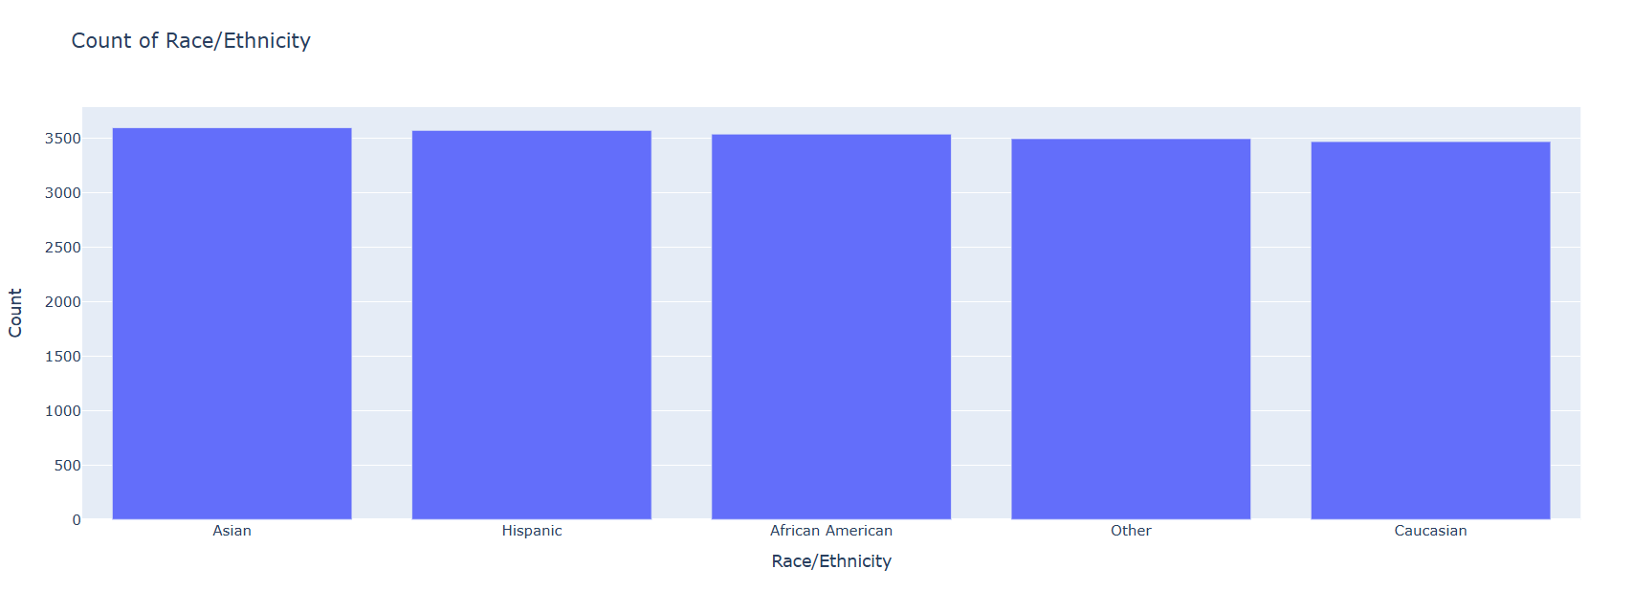
2.Find Out Count Of Race/Ethnicity And Hospital Region.
Observation:-The count of race/ethnicity and hospital region typically refers to demographic data categorizing patients by their race or ethnicity (e.g., Caucasian, Hispanic, African American) and the specific hospital region (e.g., urban, rural, geographic regions). This data helps in understanding healthcare disparities.

Slide 7
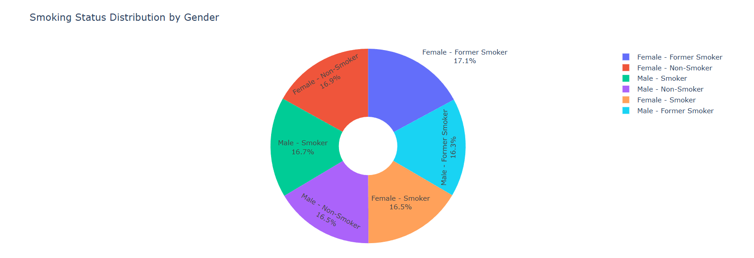
3.Find Out Smoking Status Distribution By Gender.
Observation:- Smoking status distribution by gender refers to the breakdown of smoking behaviors (e.g., current smoker, former smoker, never smoked) based on gender categories (e.g., male, female). This data helps to understand gender-specific trends in smoking habits and associated health risks.

Slide 8
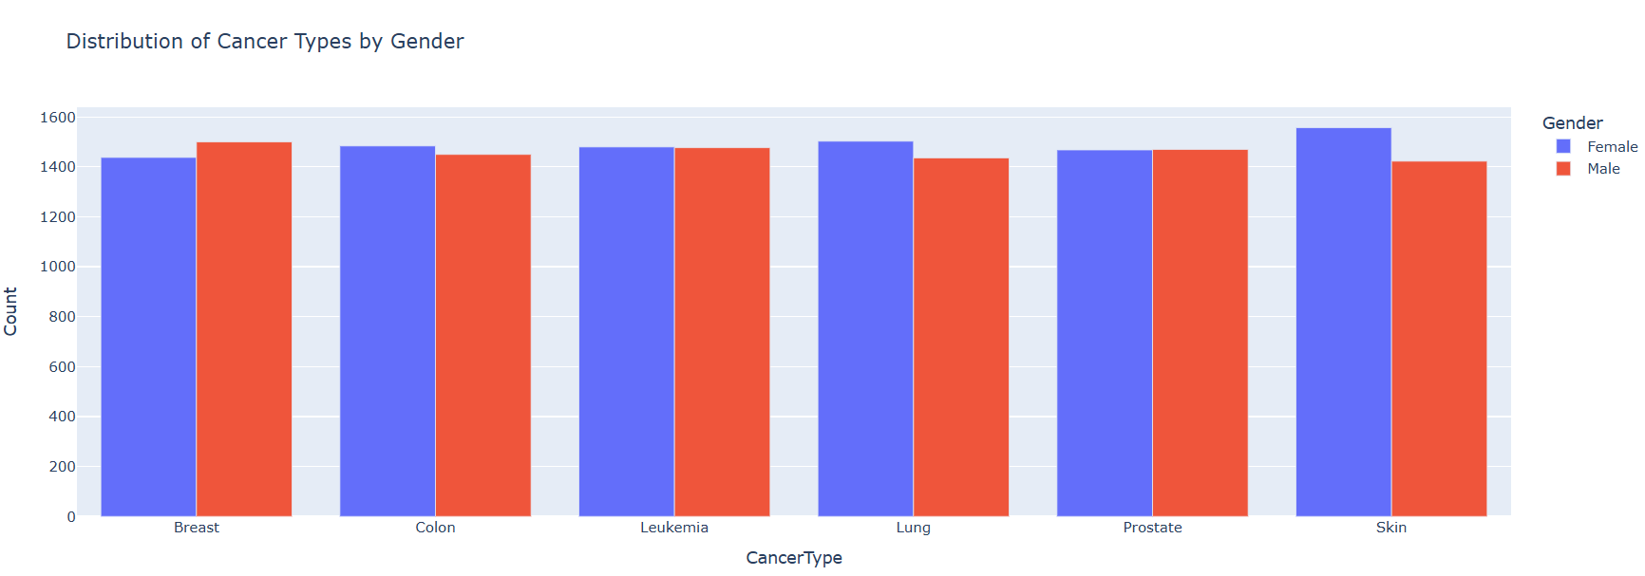
4.Find Out Distribution Of Cancer Types.
Observation:-The distribution of cancer types refers to the prevalence and occurrence of different cancer forms, such as lung, breast, prostate, or colorectal cancer. Understanding this distribution helps identify the most common types, risk factors, and priorities for research and treatment.

Slide 9
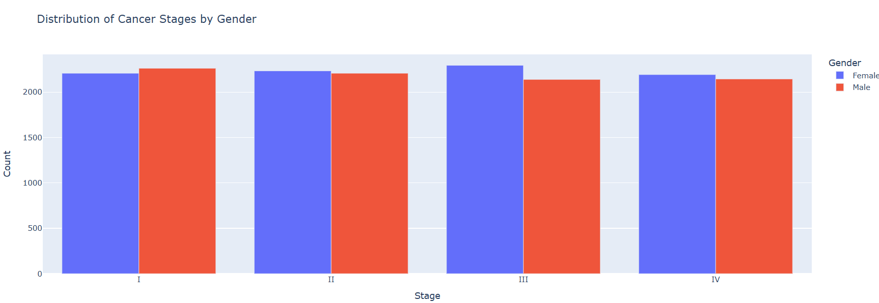
5.Find Out Distribution Of Cancer Stage.
Observation:-The distribution of cancer stages refers to the proportion of cancer cases diagnosed at various stages, such as stage 1 (early) to stage 4 (advanced). This information helps evaluate early detection effectiveness and treatment outcomes for different cancer types.

Slide 10
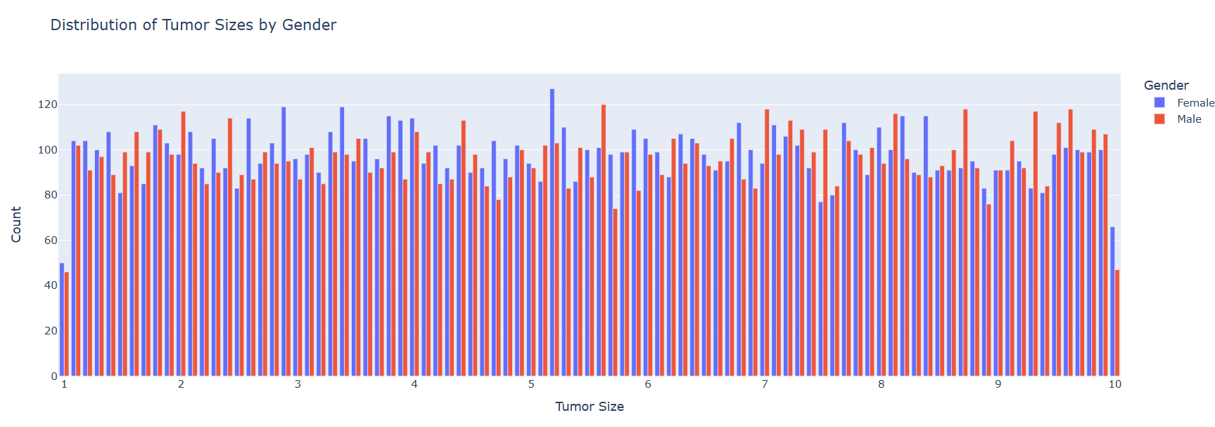
6.Find Out Distribution Of Tumor Size.
Observation:-The distribution of tumor size refers to the range of sizes observed in cancerous tumors, typically categorized as small, medium, or large. This data is crucial for determining cancer progression, treatment options, and prognosis for different cancer types.

Slide 11
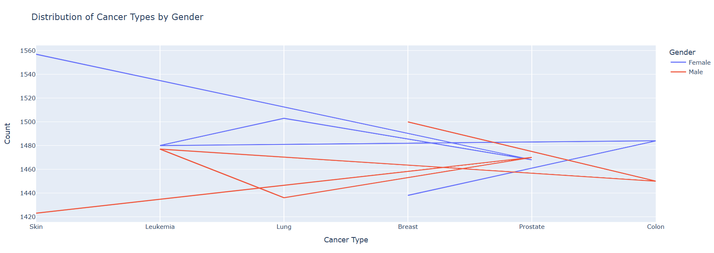
7.Find Out Distribution Of Cancer Types By Gender.
Observation:-The distribution of cancer types by gender refers to the breakdown of various cancers (e.g., breast, lung, prostate) in male and female populations. This data helps identify gender-specific cancer trends, risk factors, and guide personalized prevention and treatment strategies.

Slide 12
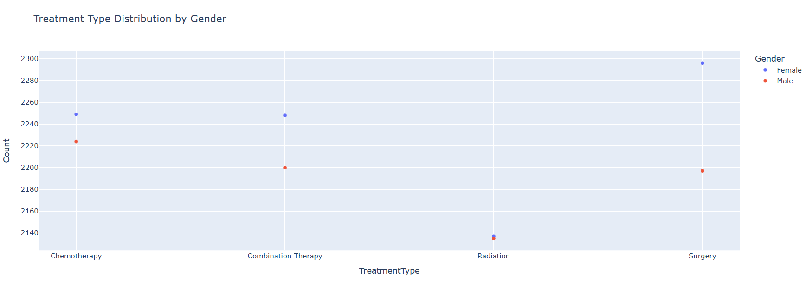
8.Find Out Treatment Type Distribution By Gender.
Observation:-The treatment type distribution by gender refers to how different treatments (e.g., surgery, chemotherapy, radiation, immunotherapy) are administered across male and female patients. Analyzing this data helps understand gender-based differences in treatment patterns, effectiveness, and health outcomes.

Slide 13
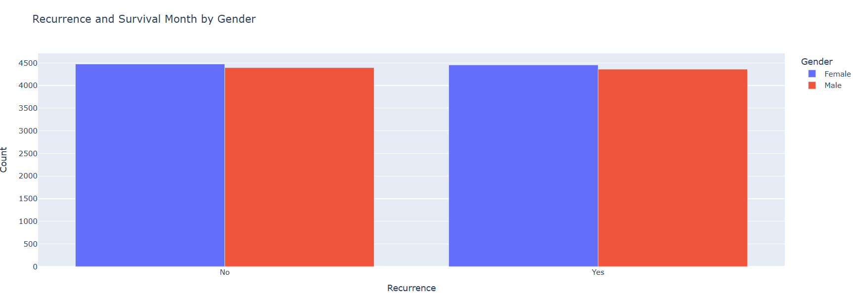
9.Find Out Recurrence And Survival Month By Gender.
Observation:-Recurrence and survival month by gender refers to the tracking of cancer recurrence rates and survival durations across male and female patients. Analyzing this data helps understand gender-specific trends in cancer prognosis, treatment effectiveness, and long-term outcomes.

Slide 14
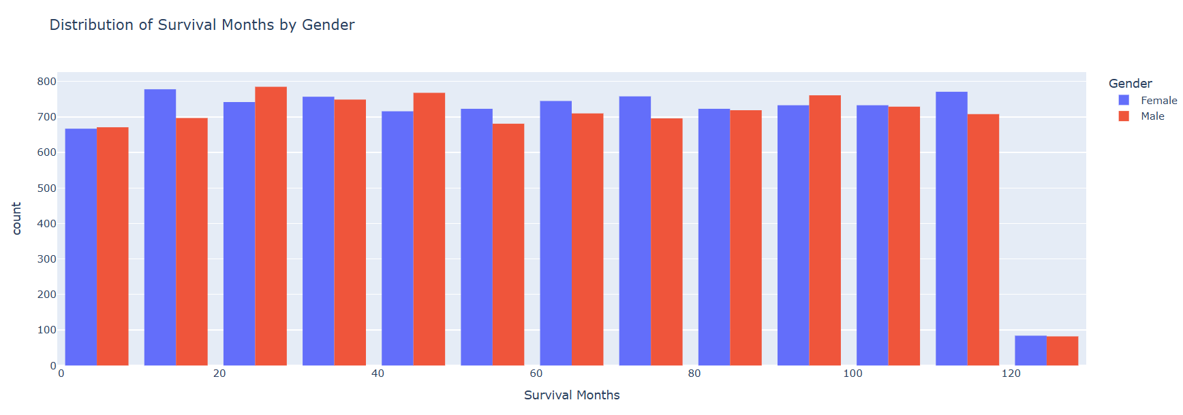
10.Find Out Distribution Of Survival Months By Gender.
Observation:-The distribution of survival months by gender refers to the variation in the length of survival after cancer diagnosis, categorized by male and female patients. This data helps identify gender-based differences in cancer outcomes, treatment responses, and prognosis.

Slide 15

Conclusion:-
In conclusion, cancer analysis provides valuable insights into the prevalence, risk factors, and outcomes of various cancer types. By examining factors such as race/ethnicity, gender, tumor size, stage at diagnosis, and treatment patterns, we gain a deeper understanding of how cancer affects different populations. This data is essential for identifying trends, improving early detection, and tailoring personalized treatment strategies to increase survival rates and reduce recurrence.
The distribution of cancer types by gender, as well as the treatment types and survival outcomes, highlights important disparities that can inform healthcare practices and interventions. For example, understanding how specific cancers disproportionately affect certain genders allows for more targeted prevention efforts, while analyzing treatment responses helps optimize care for both men and women.
Moreover, analyzing recurrence and survival rates provides crucial information for enhancing cancer care and follow-up strategies. Gender-based differences in these outcomes emphasize the need for tailored approaches to cancer management, ensuring that each patient receives the most appropriate care.
Ultimately, cancer analysis serves as a cornerstone for improving public health efforts, advancing research, and guiding healthcare policies to combat cancer more effectively and reduce its impact on individuals and communities worldwide.

Slide 16
Thank You So Much

